Slide 1


Slide 2

Online Ordering and InventoryManagement
System for Tarboosh Inc. with
Android Mobile Application
BY GROUP TESERRACT

Slide 3
Introduction
Tarboosh Inc. is a factory and founded on June 2007 by Luame “Amy” Bebayo.
They sell paper products like paper plates and containers and the supplier of Goldilocks and Jollibee.
The places that they usually supply are Manila, Divisoria, Quezon
City, Makati, Valenzuela, Baguio, Iloilo, Zamboanga, Cebu and Samar.

Slide 4
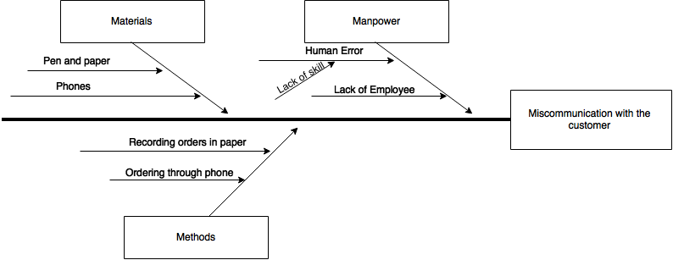
Fishbone Diagram

Slide 5
General Objectives
The general objective of the study is to develop an Online Ordering with Inventory Management System with Android Mobile Application for the employees of the Tarboosh Inc. With the use of Php and Java as the programming language and MySQL for the Database.

Slide 6
Specific Objectives
To develop a web and mobile ordering system for Tarboosh Inc that would allow them to easily sell their products online.
The system would go through alpha, beta , and user acceptance testing

Slide 7
Specific Objectives
To develop the content management system module for the administrator that would allow the administrator to change the contents of the website.
To create the audit trail module for the administrator that would allow the administrator see the transactions for delivery.
To develop the transaction module for the administrator The administrator can view pending bills and change the status whether they are paid or not.
To create a manage inventory module for the administrator that would enable them to add, edit, deactivate and search for a specific item in the inventory.

Slide 8
Specific Objectives
To create a manage inventory module for the secretary that would enable them to add, edit, deactivate and search for a specific item in the inventory.
To build the delivery module that would enable the secretary to manage the delivery schedule.

Slide 9
Specific Objectives
To create the ordering module for customers that would enable them to order their desired products easily.
To develop the transaction module for the customer, the customer can view there pending bills.
To create a complaints module for the customer that would enable them to comment about anything related to the company
To create a cancelled order module for the customer that enables them to cancel order, if they don't want to process the said transaction if and only if the transaction is not yet being process.

Slide 10
Web Features
Listed are the features of the Administrator
• Manage Transactions
• Manage Inventory
• Manage Accounts
• Backup Database
• Manage Banner
• Manage Faq’s

Slide 11
Web Features
Listed are the features of the Secretary
• Manage own account
• Manage inventory
• Manage transaction
• Manage delivery schedule

Slide 12
Web Features
Listed are the features of the Client
• Manage own account
• Request order
• View transaction
• View delivery status

Slide 13
Mobile Features
Listed are the features of the Secretary
• View Inventory
• View Delivery Schedule
• View Transactions

Slide 14
Mobile Features
Listed are the features of the Driver
• View Schedule
• Update Delivery Status
• Manage Account
• Upload Picture

Slide 15
Mobile Features
Listed are the features of the Client
• View Transaction
• View Delivery

Slide 16
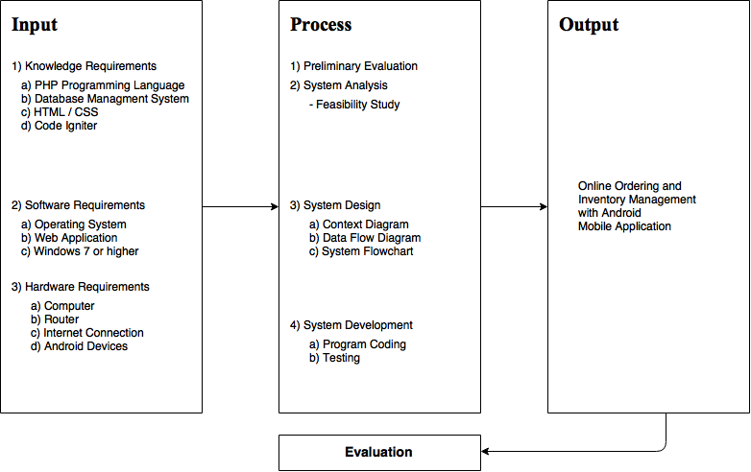
Input Process Output

Slide 17
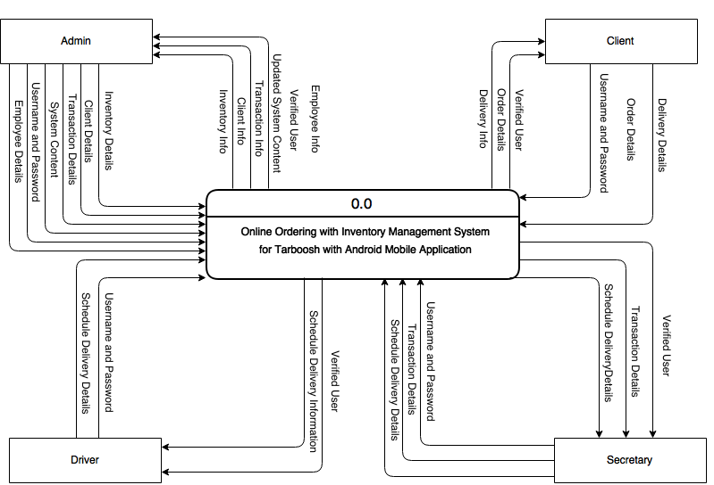
Context Diagram

Slide 18
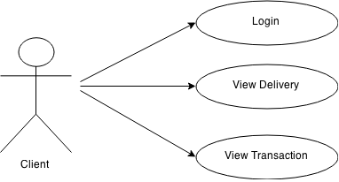
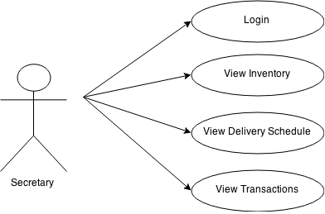
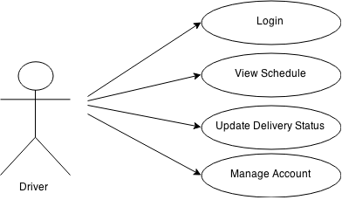
Use Case Diagram

Slide 19
Tests

Slide 20
Summary of Findings
There were three tests that were done in each test there were different progress .
After every testing an increase in progress is shown in the system but still there are modules that failed the testing.
Some modules were not working since the proponents focused on developing the main processes first.
Some of the modules in the mobile applications resulted also in failure.

Slide 21
Conclusion
Developed a web and mobile ordering system that allowed the company to sell their products online
Created the audit trail module for the administrator to see the daily transactions
Built the delivery module that enable the secretary to manage the delivery schedule
Created the ordering module for the customers that allowed them to order their desired products

Slide 22
Recommendations
In this capstone project, the proponents suggest that the future researchers may improve the current project through more research, investigation.
They can also create a mobile application in other platforms like IOS, Windows and Blackberry.

Slide 23
THANK YOU

